Slide 1

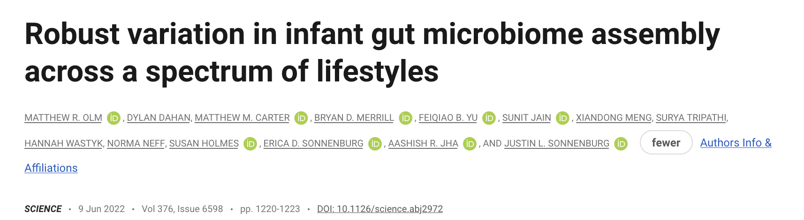
Led by
Anthony Grigsby and Chance Roberts
MIP 505
2026-02-11
Notes:
Olm was a postdoc at Stanford is now a professor at CU Boulder (h-index of 28)
Senior Author, Justin Sonnenburg, is a professor at Stanford (H-index of 82)
Science impact factor is 47.73

Slide 2
Infant microbiome assembly has been intensely studied in infants from industrialized nations, but little is known about this process in nonindustrialized populations. We deeply sequenced infant stool samples from the Hadza hunter-gatherers of Tanzania and analyzed them in a global meta-analysis. Infant microbiomes develop along lifestyle-associated trajectories, with more than 20% of genomes detected in the Hadza infant gut representing novel species. Industrialized infants-even those who are breastfed-have microbiomes characterized by a paucity of Bifidobacterium infantis and gene cassettes involved in human milk utilization. Strains within lifestyle-associated taxonomic groups are shared between mother-infant dyads, consistent with early life inheritance of lifestyle-shaped microbiomes. The population-specific differences in infant microbiome composition and function underscore the importance of studying microbiomes from people outside of wealthy, industrialized nations.
->
Olm et al. performed deep metagenomic sequencing on infant stool samples from the Hadza hunter-gatherers of Tanzania and combined them with a global meta-analysis of 1,900 samples across 18 populations, revealing that infant microbiomes develop along lifestyle-associated trajectories that diverge within the first six months of life.
Olm et al., Science 376, 1220-1223 (2022)

Slide 3
Authors
Paper Details
Corresponding Author:
Justin L. Sonnenburg
Stanford University,
Dept. of Microbiology and Immunology
Co-First Authors:
Matthew R. Olm & Dylan Dahan
Funding: NIH (DP1-AT009892, R01-DK085025), NSF GRFP, Bill & Melinda Gates Foundation
Journal:
Science (Impact Factor ~56)
Published:
Matthew R. Olm & Dylan Dahan
Data Availability: BioProject PRJEB49206
Ethical Note:
MTA w/ Tanzania NIMR; verbal consent from Hadza w/ translator
Olm et al., Science 376, 1220-1223 (2022)

Slide 4
Research Motivation
Knowledge Gap
The infant gut microbiome undergoes a critical assembly process beginning at birth. Species acquired early may shape the final adult microbiome through niche partitioning and establishment.
Microbiome assembly is well-characterized in industrialized infants, but largely unknown in non-industrialized populations, including hunter-gatherer societies like the Hadza of Tanzania.
Research Questions
When do infant microbiomes from different lifestyles diverge?
What microbes and functions characterize infants from different lifestyles?
Are there differences in taxa vertically transmitted from mothers to infants that seed the assembly process?
Olm et al., Science 376, 1220-1223 (2022)

Slide 5
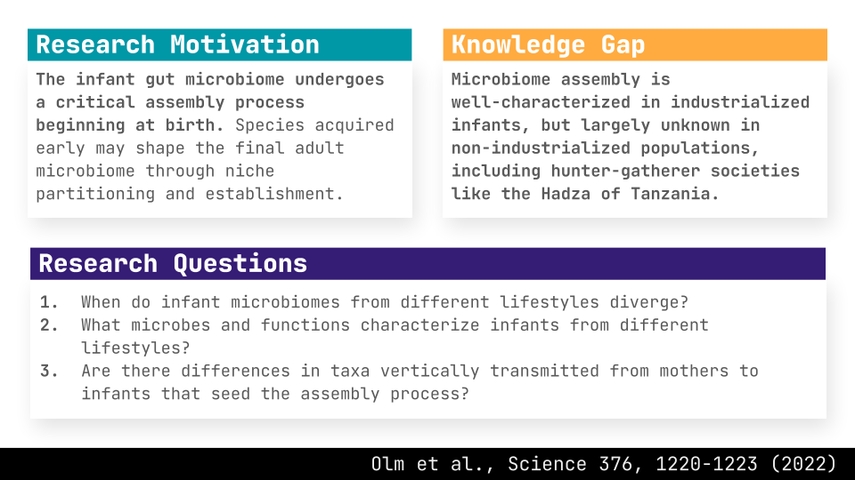
Industrialization impacts the gut microbiome of infants, which can be seen both temporally in development and in the functions the microbes conduct.

Slide 6
Experimental Design
16S rRNA Meta-analysis
“Deep” Metagenomics
Comparative Framework
1,900 samples
39 Hadza infants
3 lifestyle categories
across 18 global populations
+ 23 matched maternal samples
Analyses:
- MAG assembly & binning
- Sub-species variation
- Functional potential
(HMO genes)
- Vertical transmission (inStrain)
Non-industrialized
Hadza, Bolivia (Tismane)
Transitional
Bangladesh, Malawi, Peru, India, Nigeria
Industrialized
US, Sweden, Finland, Germany, Estonia, Russia
Includes:
- 62 Hadza infant samples
- Industrialized populations (US, Sweden, Finland, etc.)
- Transitional populations (Bangladesh, India, Peru)
- Non-industrialized
(Hadza, Bolivia, Tsimane)
Olm et al., Science 376, 1220-1223 (2022)

Slide 7
Key Methods
Amplicon Sequencing
Metagenome Assembly
- 16S rRNA gene sequencing (V4)
- UniFrac dissimilarity
- Co-abundance group (CAG) analysis
- Global meta-analysis of 18 populations
- Deep shotgun metagenomics on Hadza samples
- MAG binning -> 745 species
- Integrated w/ UHGG & adult genomes
- 5,755 species-rep. genome database
Functional & Strain Analysis
Statistical Methods
- HMO-utilization gene cluster mapping
- B. infantis strain-level phylo.
- inStrain strain tracking
- 20 B. infantis isolates
- EnvFit for ordination axis assoc.
- Wilcoxon tests for comparisons
- Fisher’s exact test w/ FDR
- in silico rarefaction for depth normalization
Olm et al., Science 376, 1220-1223 (2022)

Slide 8
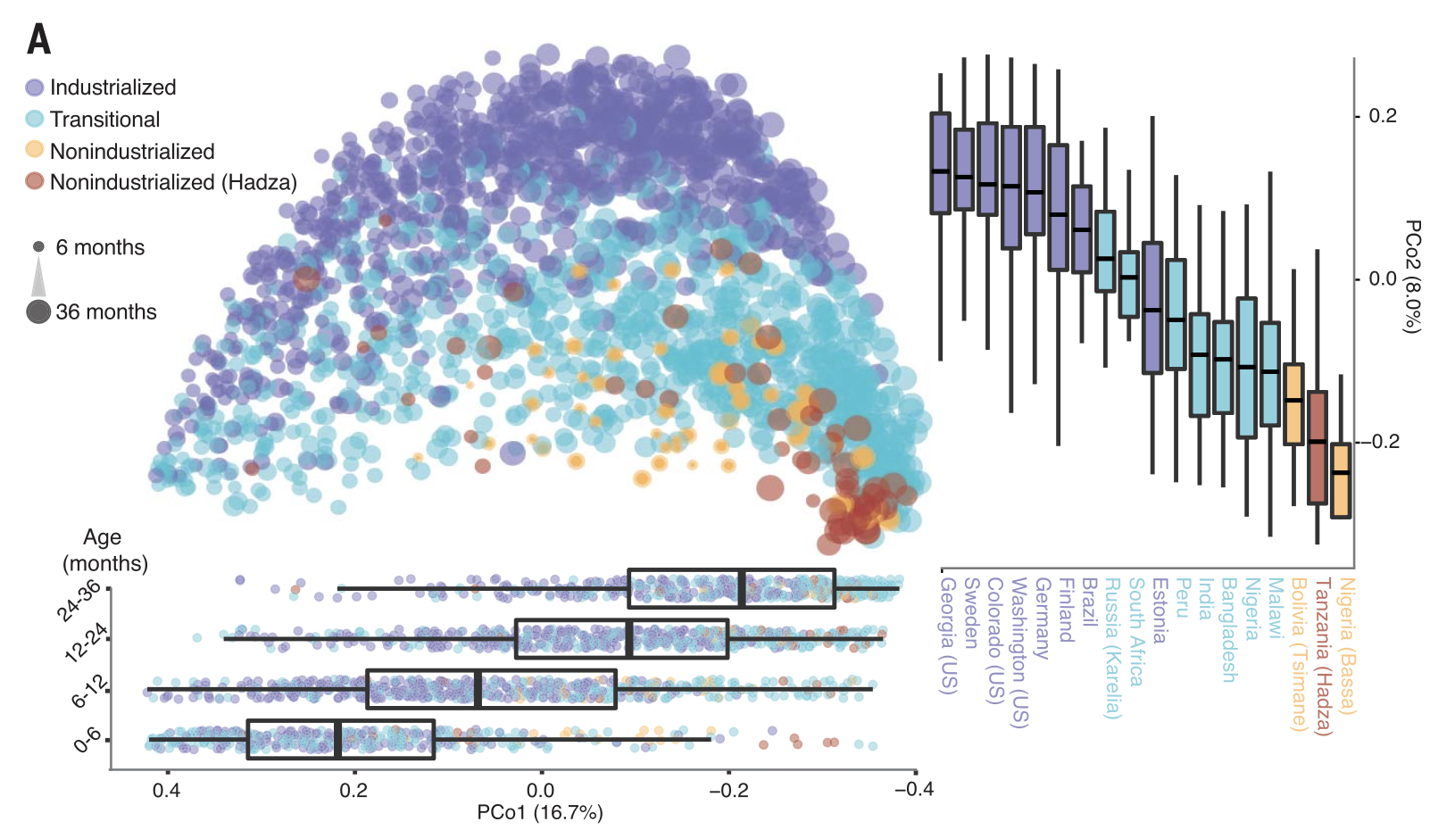
Figure 1: Age and lifestyle are associated with infant microbiome composition
Figure 1A/1B
Esther Alorkpa
(A) Unweighted UniFrac dissimilarity Principal Coordinates Analysis (PCoA) (top left panel) of 1900 fecal samples from infants (<3 years old) across 18 populations based on amplicon sequence variant abundance.
Point color indicates lifestyle and point size is proportional to age in months. Boxplots show the distribution of indicated age groups along PCo1 (bottom) and cohorts along PCo2 (right).

Slide 9
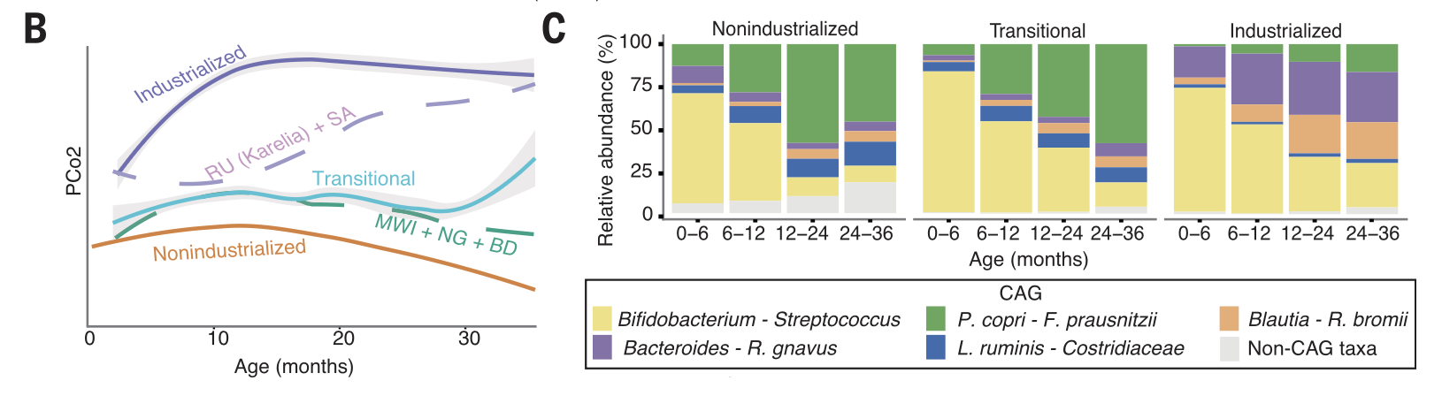
Figure 1: Age and lifestyle are associated with infant microbiome composition
Figure 1A/1B
Esther Alorkpa
Figure 1B/1C
Ghazaleh Aminiershad
(B) PCo2 versus sample age for the three lifestyle categories (solid lines) and specific indicated subpopulations (dashed lines). The purple dashed line includes Russia (Karelia) and South Africa [RU (Karelia) + SA] and the green dashed line includes Malawi, Nigeria (Urban), and Bangladesh (MWI + NG + BD). The middle transitional line (blue) contains all transitional samples. Lines are the smoothed conditional mean of PCo2 loadings (loess fit).
(C) Relative abundance of CAGs by age group and lifestyle. Taxa in annotation are the most abundant taxa in a CAG.

Slide 10
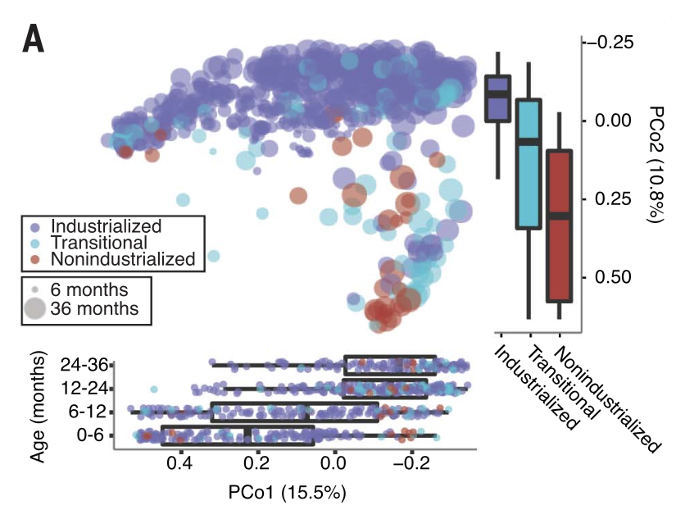
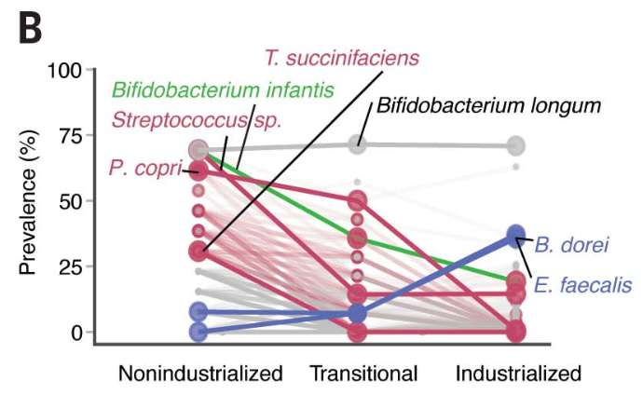
Figure 2: Age and lifestyle are associated with infant microbiome functions
Figure 2A/2B
Dominikus Atmaka
(A) PCoA on the basis of on 682 infant fecal metagenomes described at the gene abundance level in reads per kilobase million (RPKM). Points are colored by lifestyle and point size indicates infant age in months. Boxplots (bottom) show the distribution of indicated age groups in months along PCo1. Boxplots (right) show the distribution of each lifestyle along PCo2. The main axis of variation in this gene-based ordination is significantly associated with age (EnvFit; R² = 0.30; n = 679; P = 0.001) and the second axis of variation is significantly associated with lifestyle (EnvFit; R² = 0.35; n = 679; P = 0.001).
(B) Prevalence of species across lifestyles among infants 0 to 6 months old. VANISH (red and green) and BloSSUM (blue) species with the lowest adj-P values have text annotations. B. infantis is shown in orange. “Other” taxa (gray) are those that do not significantly differ according to lifestyle.

Slide 11
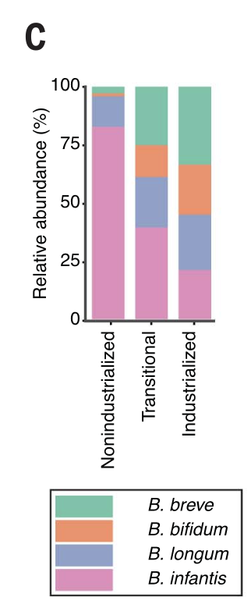
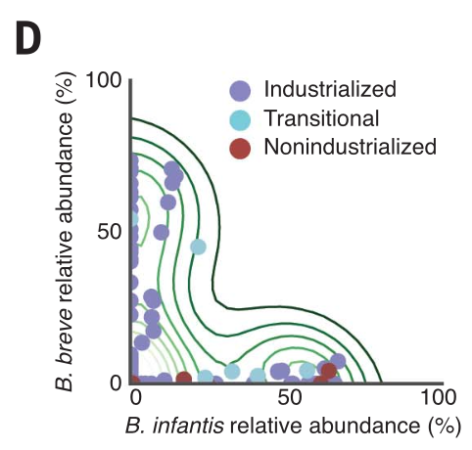
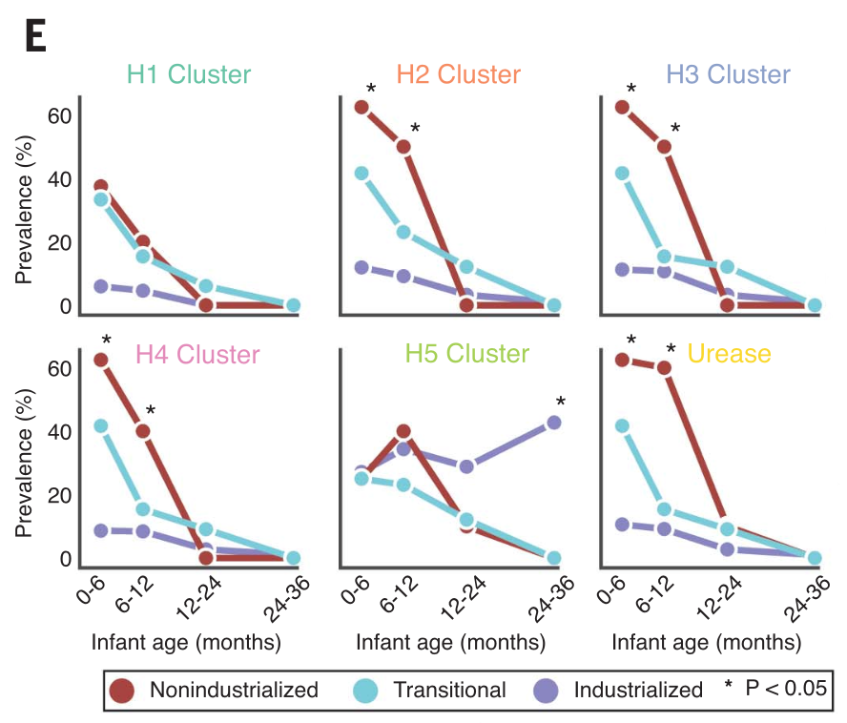
Figure 2: Age and lifestyle are associated with infant microbiome functions
Figure 2C/2D
Cristina Blanco
Figure 2E
Chayanee Chanpanich
(C) Relative representation of four common Bifidobacterium species in infants 0 to 6 months old by lifestyle.
(D) Scatterplot of B. infantis versus B. breve abundance among infants 0 to 6 months old. Contour lines display the kernel density estimation.
(E) Prevalence of HMO-utilization clusters across ages and lifestyles. Clusters are considered present if all genes in the cluster are detected above a variable coverage threshold (to ensure that results are robust to differences in sequencing depth; see methods for details). * indicates adj-P < 0.05; Fisher’s exact test with false discovery rate correction; nonindustrialized versus industrialized.

Slide 12
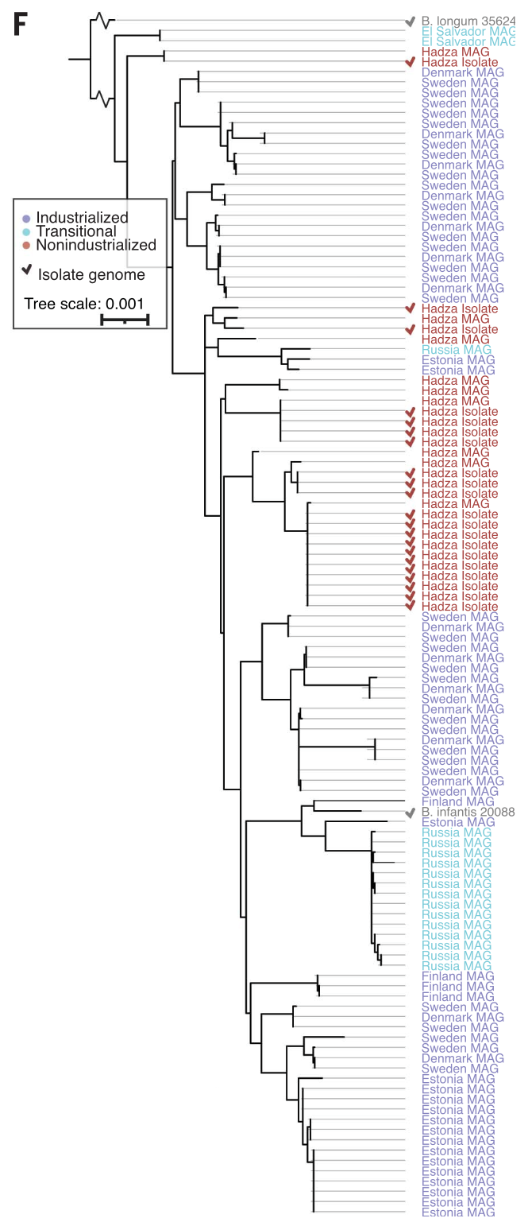
Figure 2: Age and lifestyle are associated with infant microbiome functions
Figure 2F
Amara Onwunzo
->
(F) Phylogenetic tree of B. infantis genomes based on universal single copy genes. Genome names are colored on the basis of lifestyle of origin. Isolate genomes are marked with a checkmark. Public reference genomes for B. longum and B. infantis are included (gray text).

Slide 13
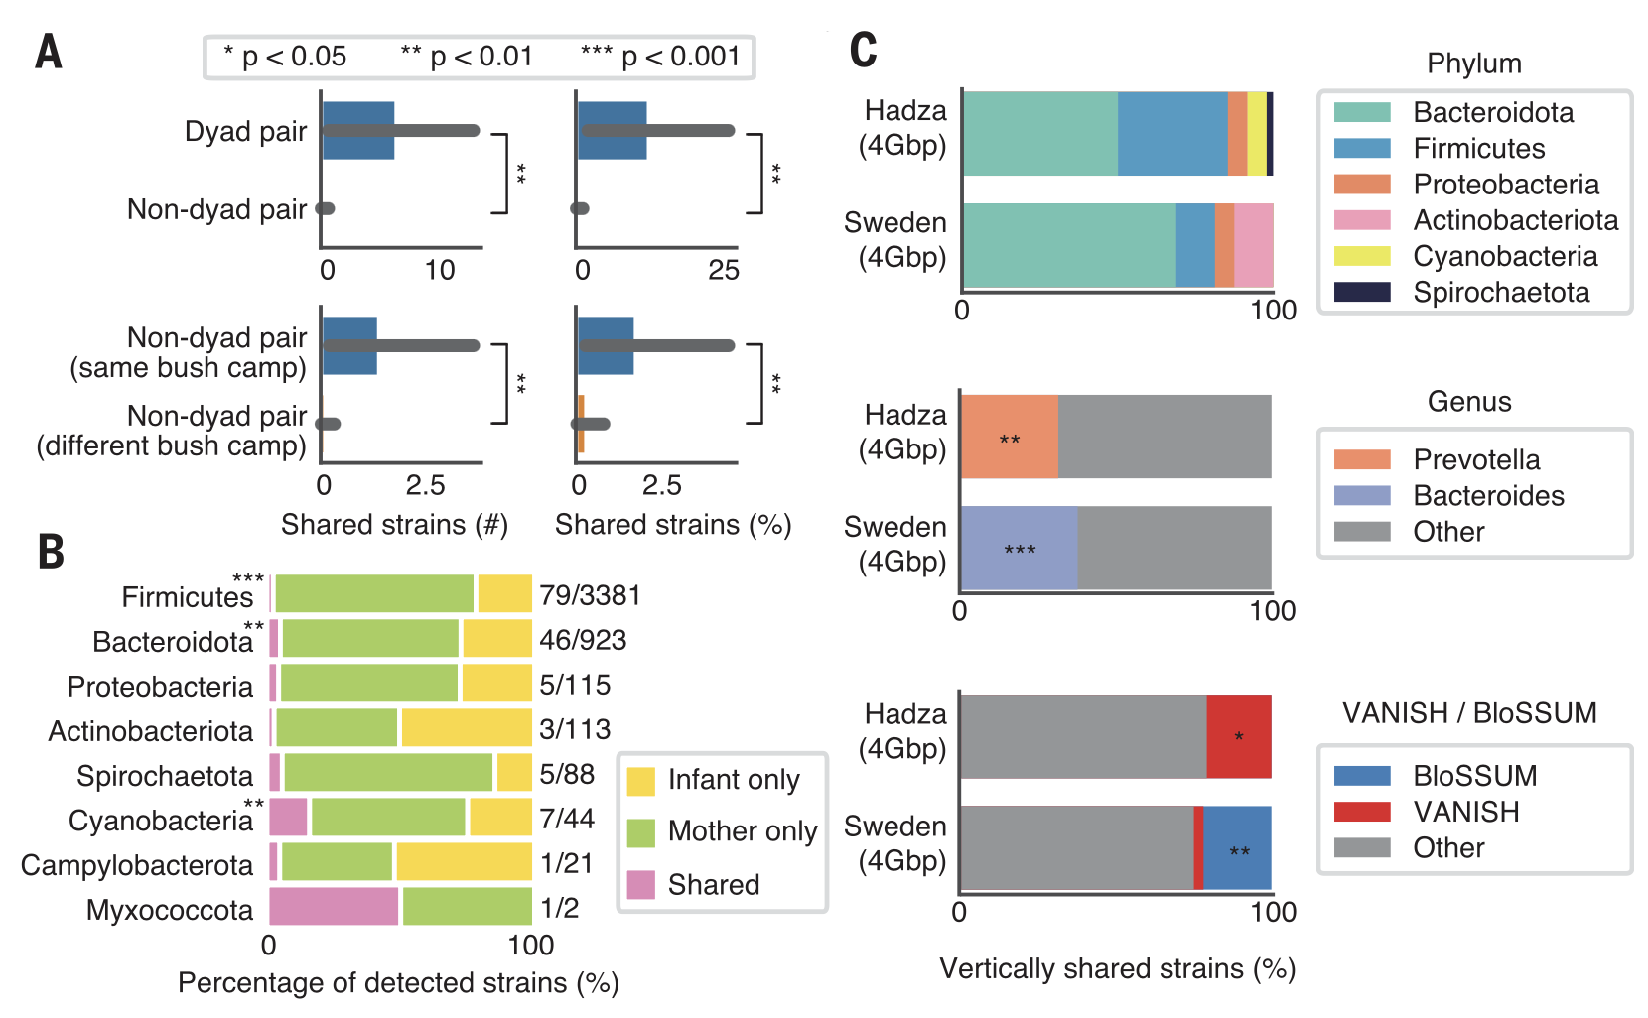
Figure 3: Strain sharing between mother-infant dyads and non-dyads is lifestyle-specific
Figure 3A
Santiago G. Gonzalez
Figure 3B
Melanie Wilkinson
Figure 3C
Patricia Garcia
(A) The mean strains shared (left) and the percentage of infant strains found in mothers (right) in mother-infant dyads versus mother-infant nondyads (top) and nondyads from the same bushcamp versus nondyads from different bushcamps (bottom). Error bars represent standard error (*, adj-P < 0.05; **, adj-P < 0.01; ***, adj-P < 0.001; Wilcoxon rank-sum test). (
B) Percentage of strains detected in all Hadza mothers and infants and whether they are detected in infants only, mothers only, or shared within a mother-infant dyad (“shared”) categorized by phylum. Numbers to the right of bars indicate the number of vertically shared strains over the number of strains detected in either infant or maternal samples. Phyla with a significant difference in the percentage of vertically transmitted strains as compared with all other phyla are marked with asterisks (Fisher’s exact test with P value correction).
(C) Percentage of vertically transmitted strains in Hadza and Swedish cohorts by phylum (top), genus (middle; only genera with significant differences shown), and VANISH / BloSSUM (bottom). All metagenomes were subset to 4Gbp for this analysis to remove any biases associated with sequencing depth. Taxa that are significantly enriched in either cohort are marked with an asterisk (*, adj-P < 0.05; **, adj-P < 0.01; ***, adj-P < 0.001; Fisher’s exact test)

Slide 14
Conclusions
1
Infant microbiomes develop along lifestyle-associated trajectories, diverging w/i the first 6 months of life in industrialized populations
2
23.4% of species in Hadza infant guts are novel, and the infant gut harbors extensive uncharacterized diversity
3
B. infantis and HMO-utilization gene clusters are depleted in industrialized infants, even breastfed ones; and this could impact immune development
4
310 VANISH species lost vs. only 12 BloSSUM species gained, so more diversity is lost than gained with industrialization
5
Vertical transmission is lifestyle-specific, as taxa that differentiate lifestyles are those most commonly shared between mother-infant dyads
6
Transitional populations show intermediate phenotypes, supporting lifestyle (not just geography) as a causative factor in microbiome assembly
Olm et al., Science 376, 1220-1223 (2022)

Slide 15
Question 1
Bianca Goncalves da Costa
Question 2
Alexander Jones
Question 3
Ally Mujica
Methods Critique
Eliud Rivas Hernandez
Additional Analysis
Ally Mujica
“Reviewer 3”
Catie Wharton
Olm et al., Science 376, 1220-1223 (2022)

